Slide 1
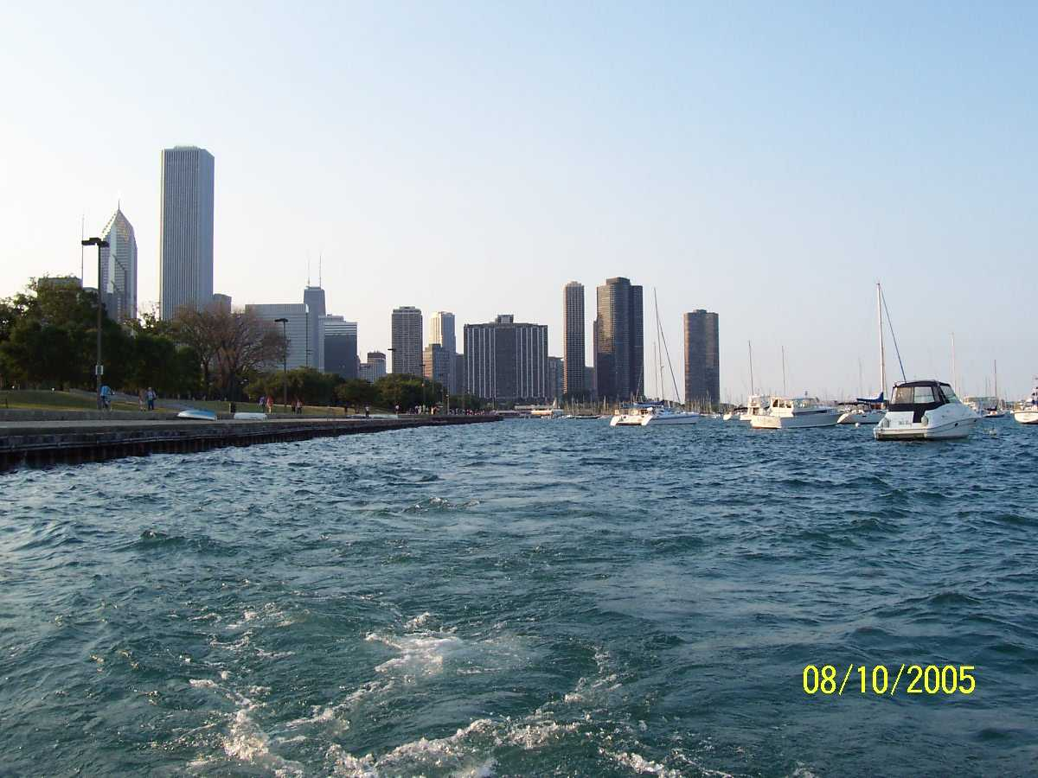
Tracing a Chicago Family’s Roots
A Case Study
Notes:
My list of do’s and don’t’s

